Slide 1



Be committed to college student rental services

Slide 2
Group
shadowrocket
Group/member
William
Caden
Palmer
Guy
Chanller
Jay

Slide 3


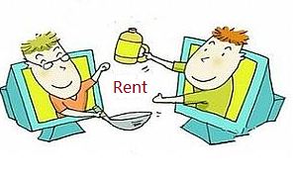
Background
In recent years, e-commerce has increasingly occupied people's lives and penetrated into every aspect of the economy and life. When we need something, our way is to buy it directly. However, after purchase, the usage rate of the product may be very low. Then it becomes a idle item in life, and the idle items in life cannot be handled. Have you ever had such troubles? I want to use a certain product for a short time, but I don’t want to buy it. Do you have such troubles?
So, is there any way to help us solve them?
The answer now is that our team has a solution.

Slide 4
What does our project do?
We developed a website platform for leasing called the Sias Rental Platform. It is an online platform for leasing products (such as electronics) and publishing rental information for targeted students.
Our goal is to provide students with a good platform for product rental information exchange, to help them solve the problem of accumulating idle products in their hands, and to enjoy life without spending a lot of money. There are a lot of websites available for renting goods, but there are few websites for college students to rent products in Sias.
We will treat the development and application of the website with a good attitude and provide a good rental platform for college students.

Slide 5
What are the functions of our program?
Manage personal information
Publish goods
Delete/Modify product
Search and view goods
Favorite Product
Settle in the shopping cart
Comments
View order status
Evaluation product

Slide 6
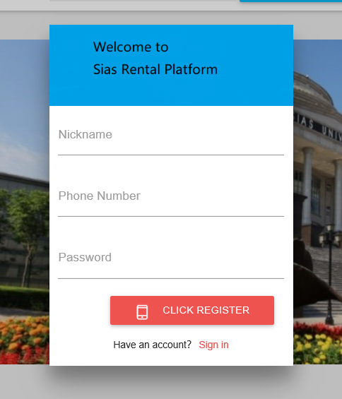
Function1: Registration
Three elements:
1.a nickname: it can be anything. 2.phone number: one number can only be registered once.
3. Password: secure enough

Slide 7
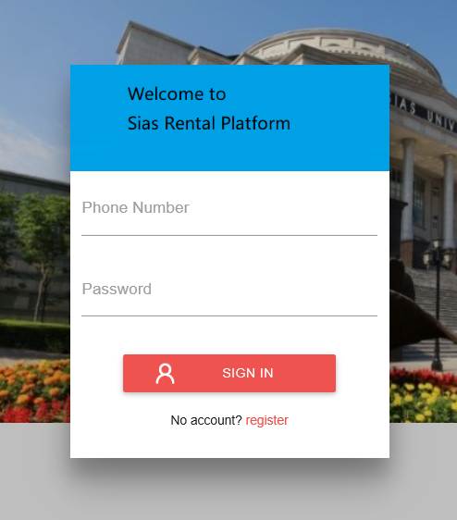
Function2: Login
1.Click login
2.enter your account.
3.Enter the password
4.click login

Slide 8
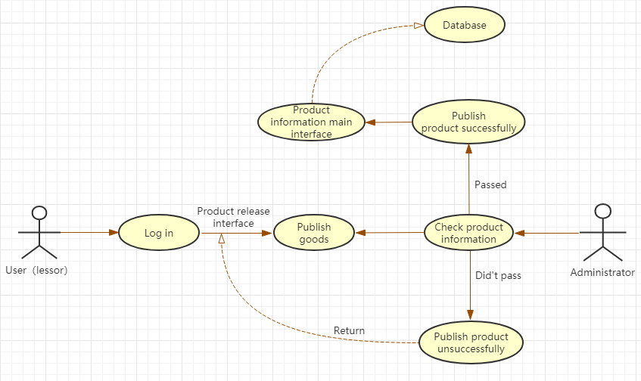
Function4: Publish goods
Uploading a product is a very important part for the user（lessor）. The user first has to log in to the website, enter the product release interface, and then publish the product, waiting for the background administrator to check. If the check is passed, the product information will be displayed on the homepage of the website. If the check fails, the system will return to the product release interface and feedback to the user（lessor）.

Slide 9
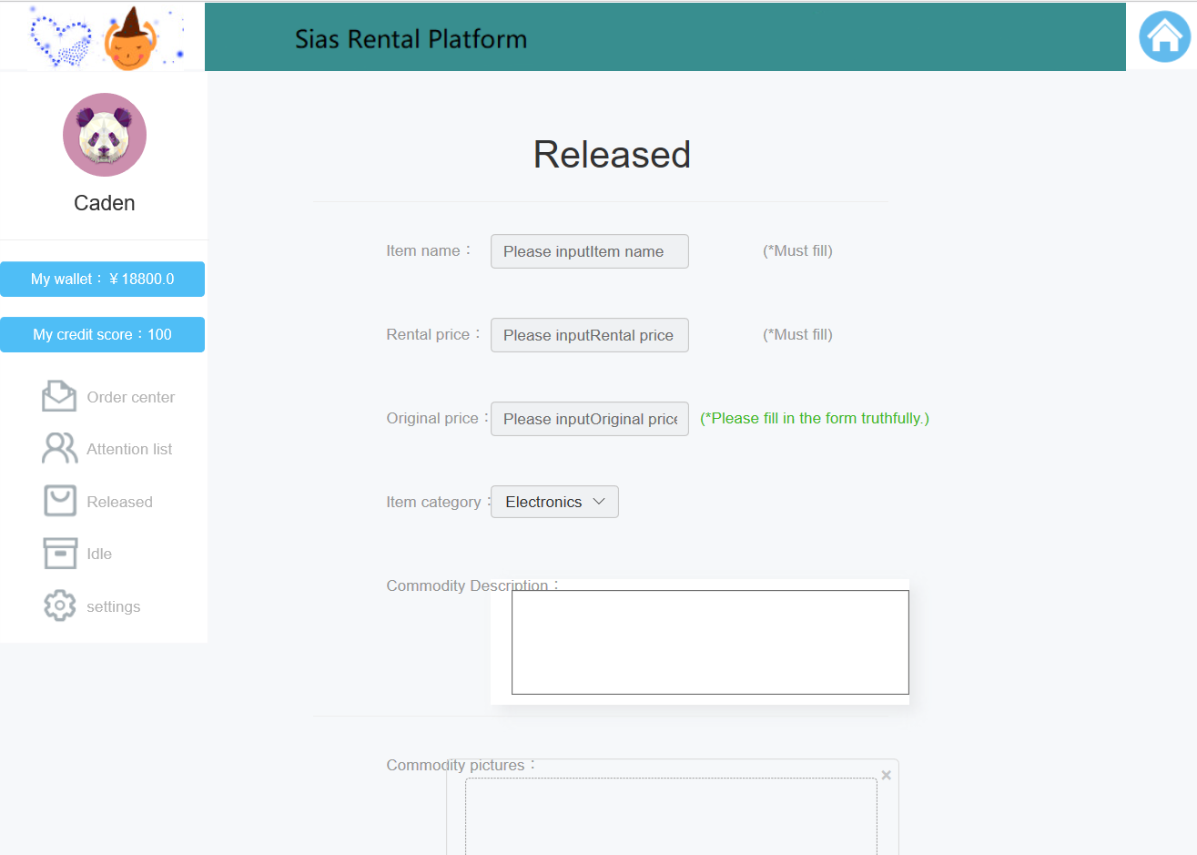
Publish goods

Slide 10
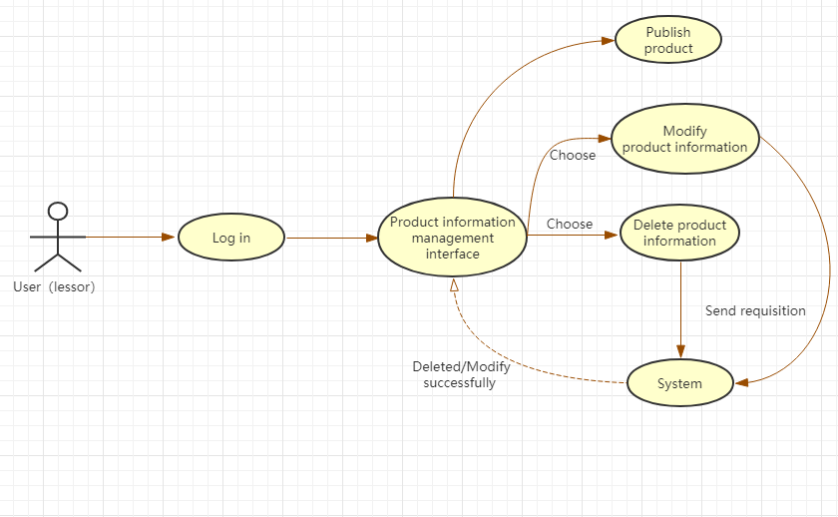
Function5: Delete/Modify product
If the user（lessor） wants to delete the published item, we use this use case to achieve. First, the user（lessor） logs in to the website, enters the product information management interface, selects the product information that you want to delete and clicks “Delete”, sends the request to the system, and finally deletes successfully, and feedback to the product information management interface. Modifying the product is also similar to this process.

Slide 11
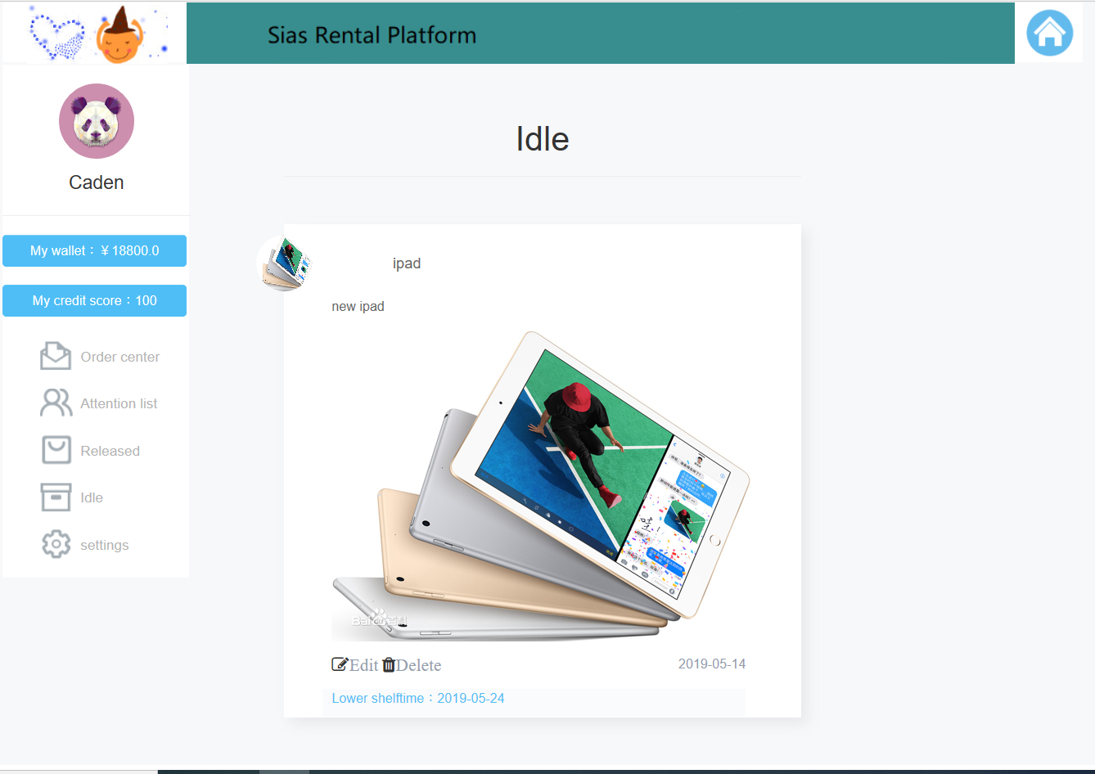
Delete/Modify product

Slide 12
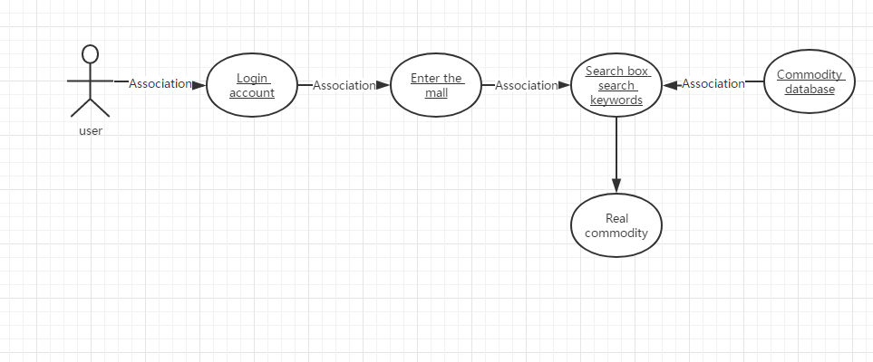
Function6: Search and view goods
1.Log on to the website account number
2.Open the mall interface
3.Click on the search box
4.Enter search keywords
6. Set your own search restrictions
5.Show search items

Slide 13
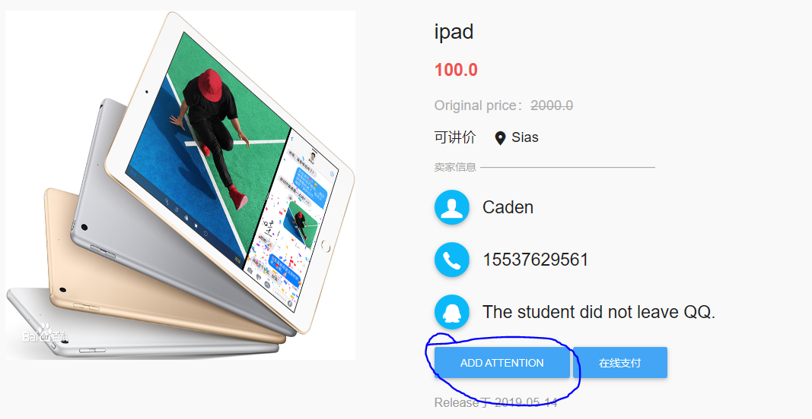
Function7: Favorite Product
When you see an item at the right price. But you don't need to buy it now. You can click on follow to collect this item into your attention. And you can view your collection by clicking on the focus item in the personal interface.

Slide 14
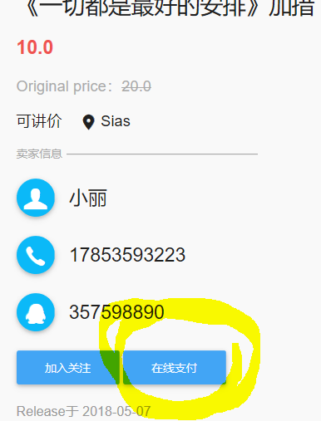
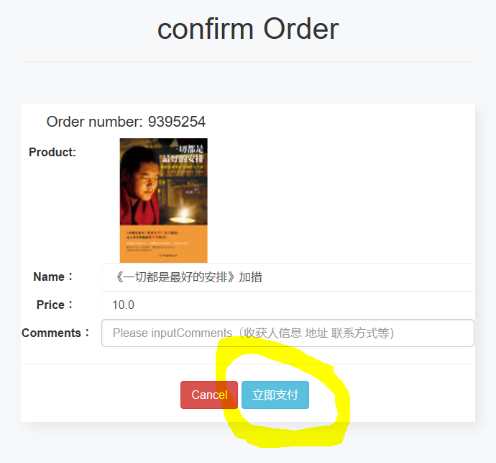
How to settle in the shopping cart of the website
The checkout is divided into multiple operating units and multiple operating procedures, namely personal, system operation and background management. However, as a settlement method of the rental system, the function of selecting the lease term is more than the ordinary settlement method. All settlement methods on the Sias campus rental website have become
1. Select the relevant products to be added
2. Click the online payment button
3. Select the settlement item
4. Use the relevant online wallet settlement
5. Successful solution, feedback voucher. Next let us enter the actual operation interface

Slide 15
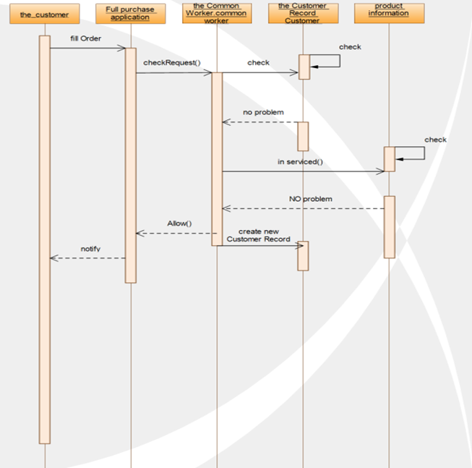
Function: How to settle in the shopping cart of the website
This is a timing diagram of how the system background is handled. When the user goes to buy or lease, part of the background operation of the system is realized. For example, adding new customer transaction information, how the user knows how his user record was checked for feedback on whether the electronic application form was approved.

Slide 16
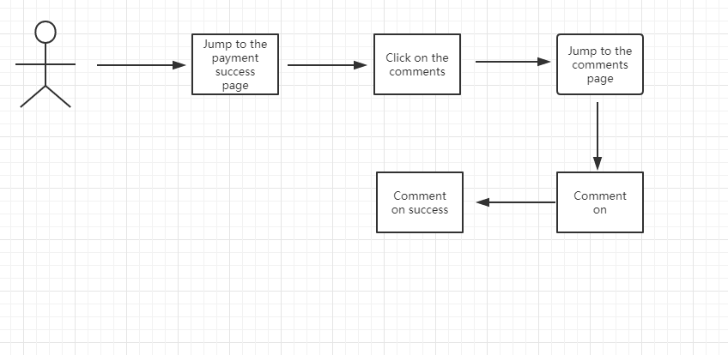
Function11: Comments
After successful payment, users can directly enter the comment page on the payment page and click the comment to directly comment.

Slide 17
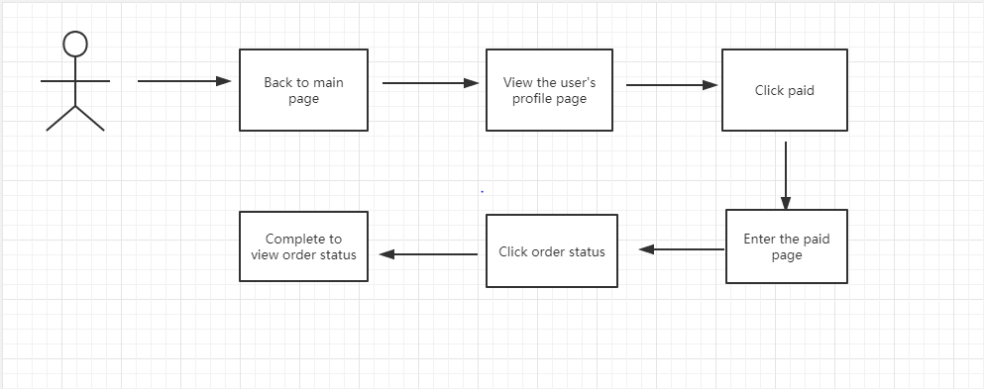
Function12: View order status
After the user has successfully paid, go back to the main page. Click "purchased" in the user's personal page, and the order status can be viewed in the purchased page.

Slide 18
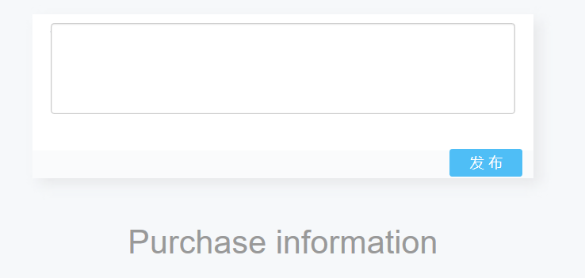
Function: Evaluation product
If our rental platform does not have the goods you want for the time being, you can publish your needs in the purchase information. When someone sees your needs, he can contact you through the contact information on the website.

Slide 19
THANK YOU FOR YOUR WATCHING

